Slide 1

BANKING SYSTEM
BY SUFFIYAN USAMI ,QASIM HASAN, AHSAN AHSRAF ,TALHA AHMED

Slide 2
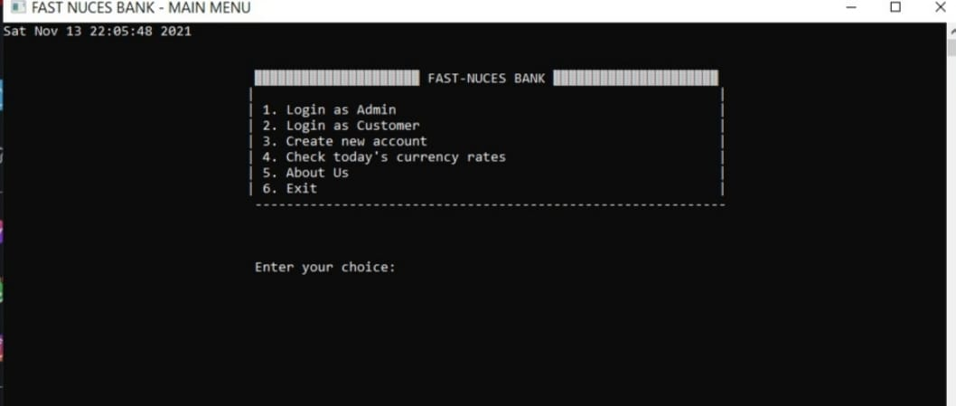
USER MANUAL: Bank interface:

Slide 3
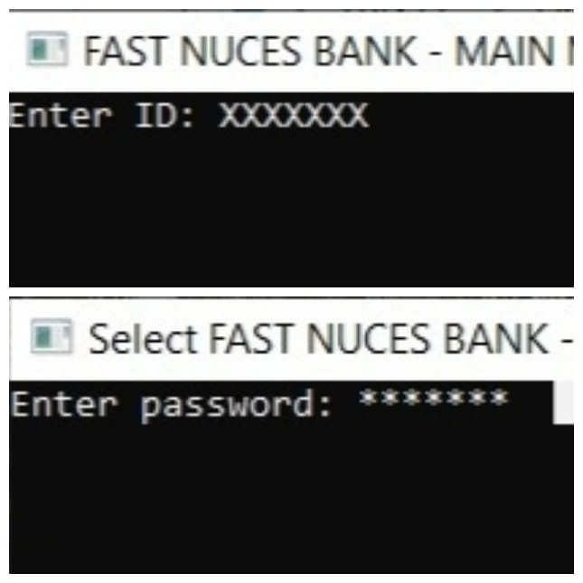
1.)Login as Admin:
Admin must have created a account(.admin file)
Password:
8 length of password in required when logging in
Enter ID:

Slide 4
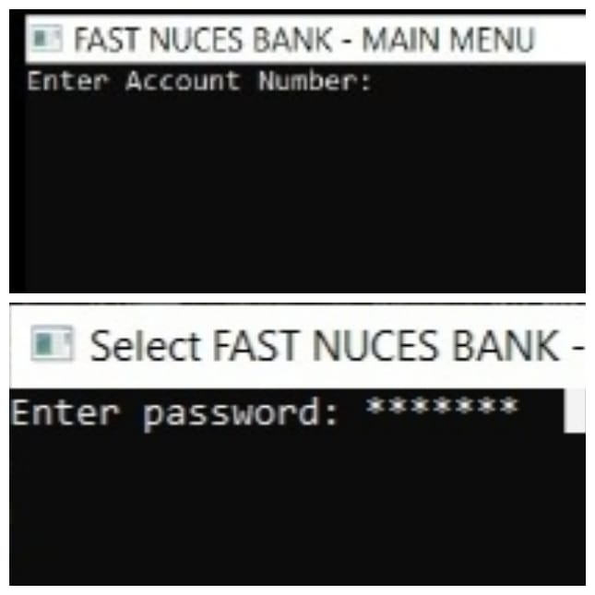
2.)Login as customer:
Enter Account Number:
Customer must have created an account before hand to login in
Password:
8 length password are accepted

Slide 5
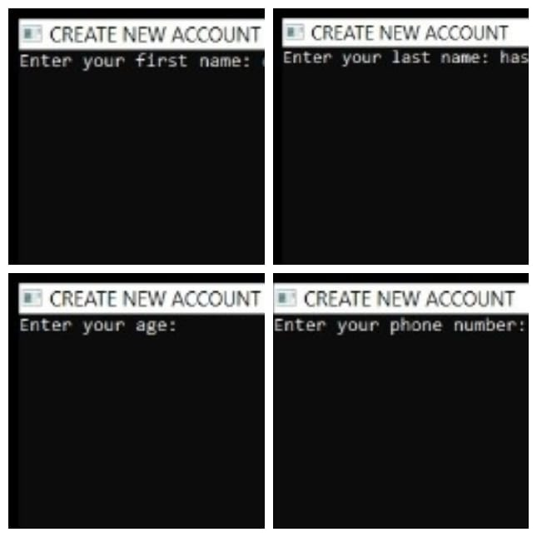
3.)Create New account:
Enter your first Name:XXXXX
It will be saved in .customer file
Enter your last Name:XXXXX
It will also be saved in .customer file
Enter your age:
Extra information for verification
Enter your phonenumber:XXXXXXXXX
Extra information taken for verification
Enter your password:
This data will be saved in .customer file

